Slide 1
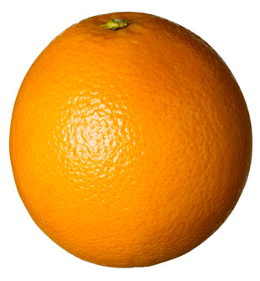
Website Programming
□ arrays □ debugging in JS □ intro to objects

Slide 2
PROGRAMMING is still easy as...
after C++
var A = document.B_form.input.C.value

Slide 3

ARRAYS
special type of variables that could store multiple values of the same type or not (not the usual array from other languages where you can store just one type of values)
arrays are actually objects (later about this)
an array is a collection of values (all in one BASKET)
an array could have an indefinite number of entries
it could be declared with or without a size (regardless of which way we use, the array will re-dimension itself)

Slide 4
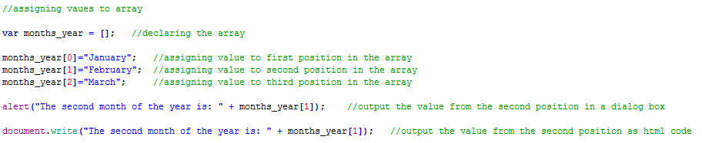
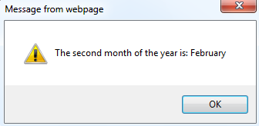
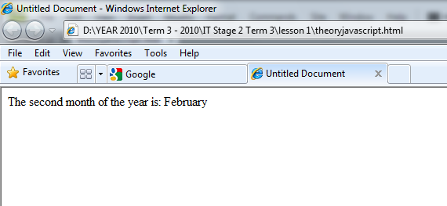
ARRAYS
the values are added one after the other one
they are accessed using an index (starting from 0)

Slide 5

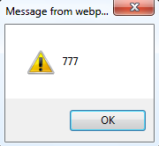
ARRAYS
how big is the array in this case?

Slide 6
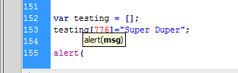
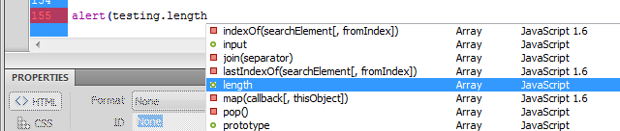
Dreamweaver has INTELISENSE
(for all JavaScript API reference go here: http://www.w3schools.com/jsref/jsref_obj_string.asp)

Slide 7

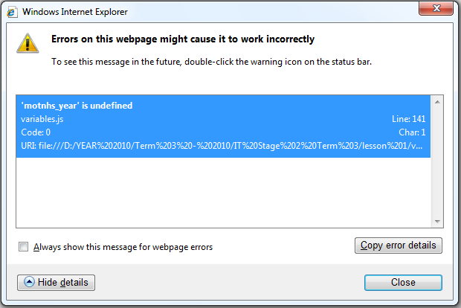
DEBUGGING JS
in IE at the bottom left will appear a yellow sign
double click the sign and an error window will appear where you can identify the error and the line that thrown that error

Slide 8
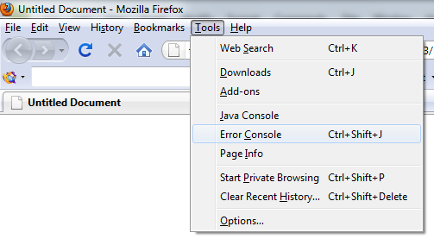
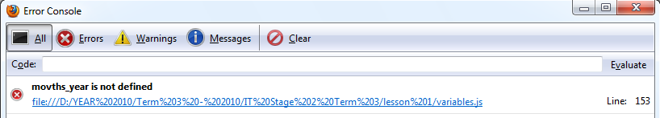
DEBUGGING JS
in FIREFOX you have an error console under TOOLS:

Slide 9

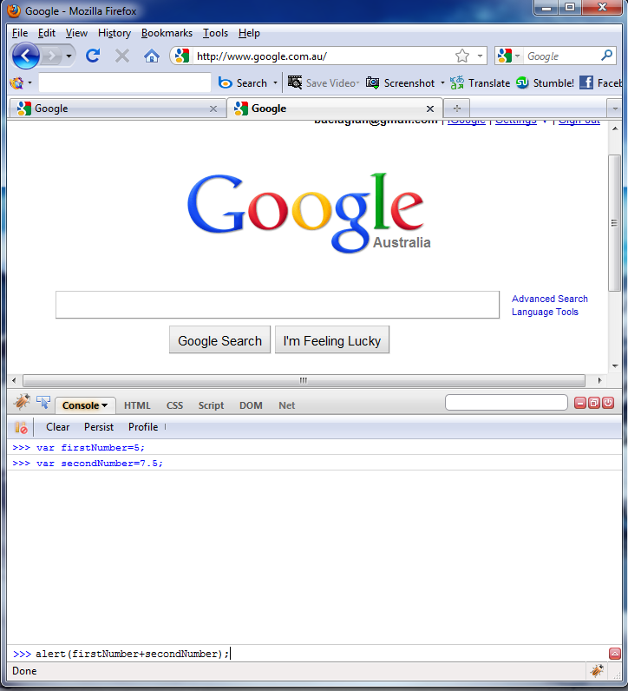

DEBUGGING JS
in FIREFOX you also have an easier way to work with JS
firebug
it is an add-on that could open a console and show you what the out put of your JS is, without using a text editor and then a browser
to open the console visit any page and then click on the little orange bug on the right bottom part of the browser

Slide 10
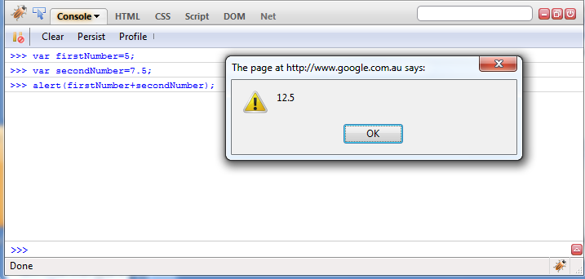
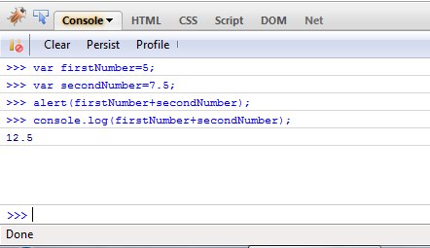
you type here
then enter
to see the result with out actually open a dialog box use a special construct:
console.log();

Slide 11
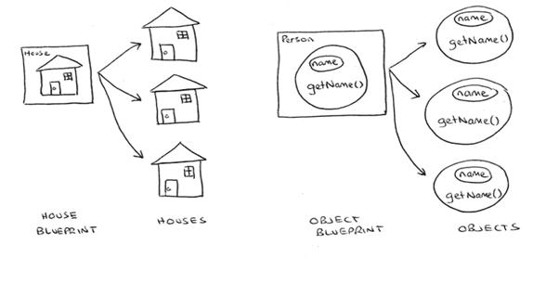
What is “new”?
“new” is a special word used to create objects from a template (it is called the constructor)
objects are a kind of variable that could contain not only data (called PROPERTIES) but also actions that could manipulate that data (called METHODS)
objects are the main concept of OOP (object oriented programming)

Slide 12
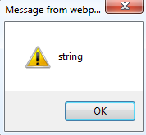
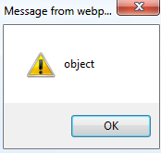
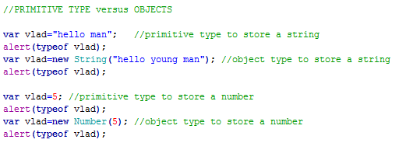

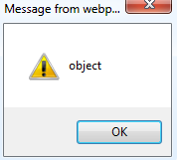
PRIMITIVE DATA TYPE versus OBJECTS DATA TYPE
JS has 5 types of PRIMITIVE DATA type (the data type that are used the most):
undefined
null
number
string
boolean
JS could also create OBJECTS for some of these data type (by doing this you can add your own methods and properties):
boolean
number
string

Slide 13

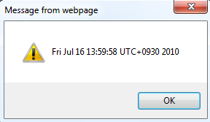
OBJECTS
in an OOP language all variables are actually objects
a variable that stores text is a STRING object, the one that stores numbers is a NUMBER object and so on
in JS we have three type of objects:
NATIVE ones provided by JS like: DATE, IMAGE, STRING, MATHS
HOST ones that are provided to JS by the browser used like: FORM, DOCUMENT, WINDOW, etc
USER DEFINED which are created by the programmer
for most used type of objects you can or not use the word "new"
always use "new" for used defined objects

Slide 14
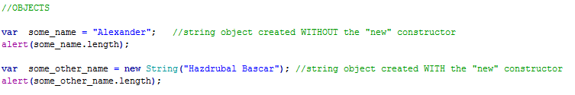
OBJECTS
the “blue print” for most used objects are provided and we just have to create new objects of that type (more precisely we say create INSTANCES of that type of object)
after object' instance creation we can use all methods and properties of that type of object
in the below example an instance of a STRING object was created and we can use already build properties like: length or methods like: charAt(), toUpper(), toLower(), split()

Slide 15
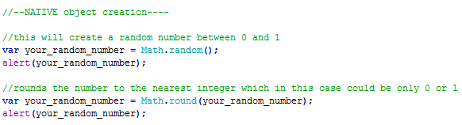
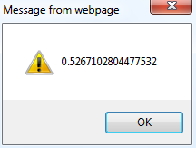
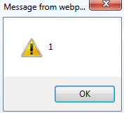
OBJECTS
in the below example an instance of a MATHS object was created twice and we can use already build methods like: random() or round()

Slide 16
USER GUIDE Task 2: Using Native Objects
Problem: you have to implement a mini tutorial that could demonstrates the use of OBJECTS in JS
minimum requirements are:
you have to demonstrate 3 NATIVE objects
each object with 4 methods or properties
instructions
user input (like text box or dropdown list or ...)
button to generate the result
output the result (up to you in what kind of form)
possibility to start again
hint: use W3SCHOOLS for inspiration

